Slide 1
The Impact of Seismic Activity
Jonathan Tuttle
Jeff Coen
Fervis Lauan
Abraham Eapen

Slide 2
What is the Impact of Seismic Activity?

Slide 3


Slide 4
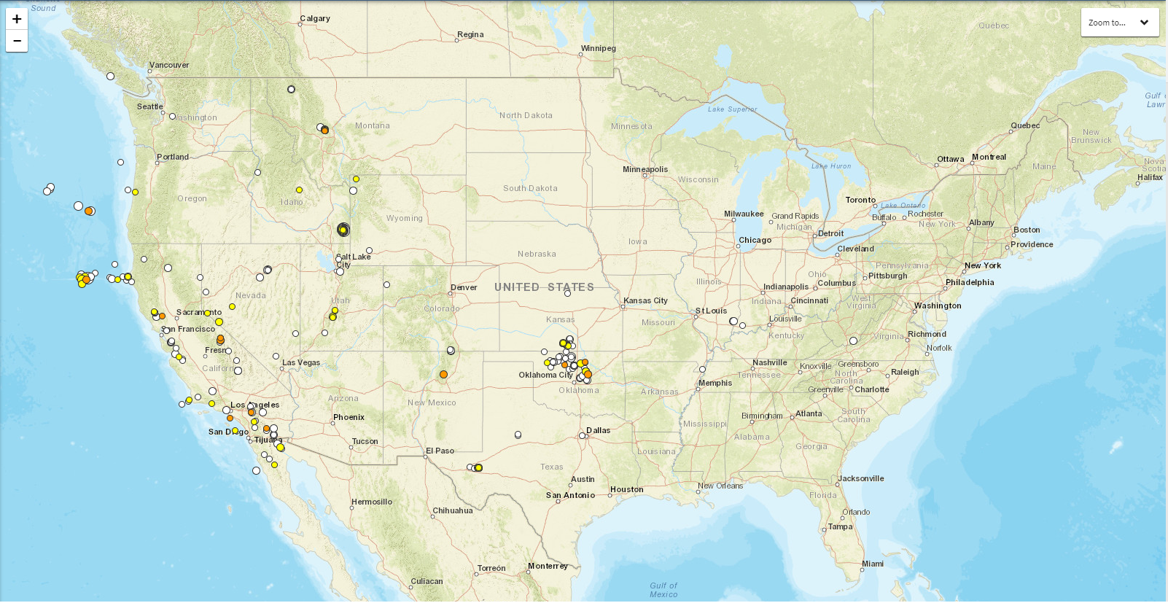
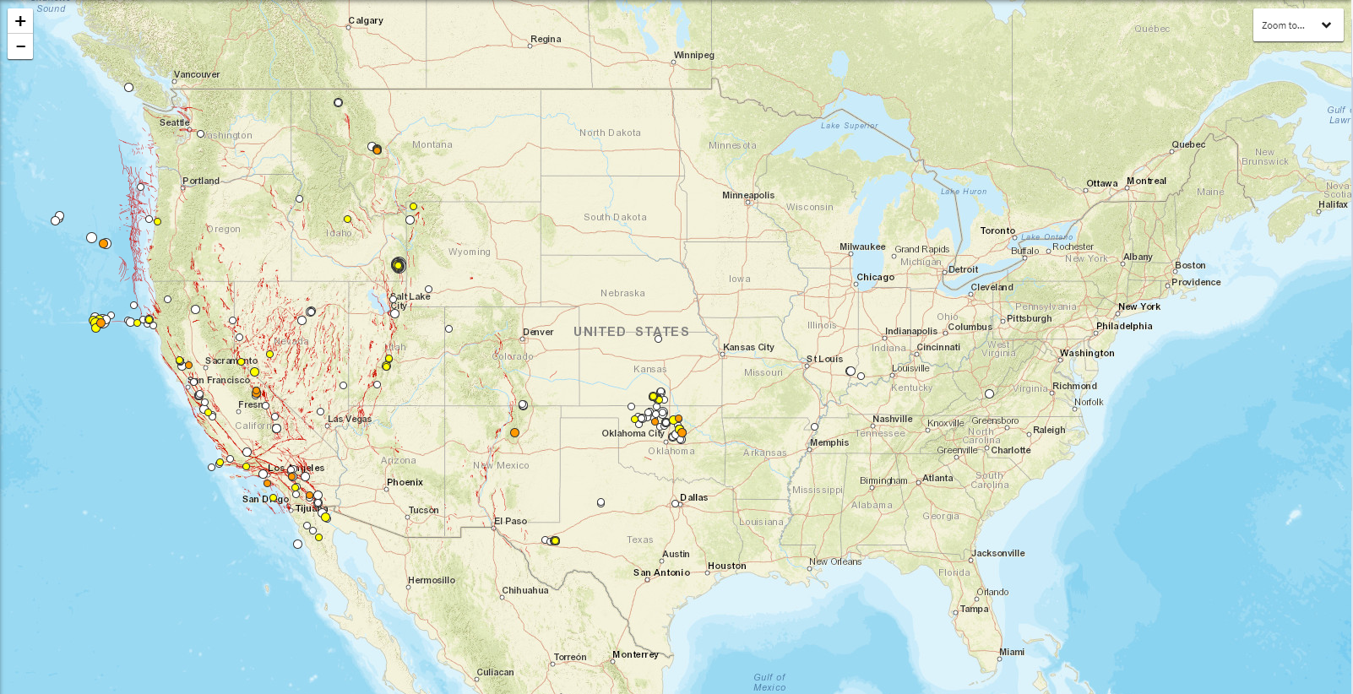
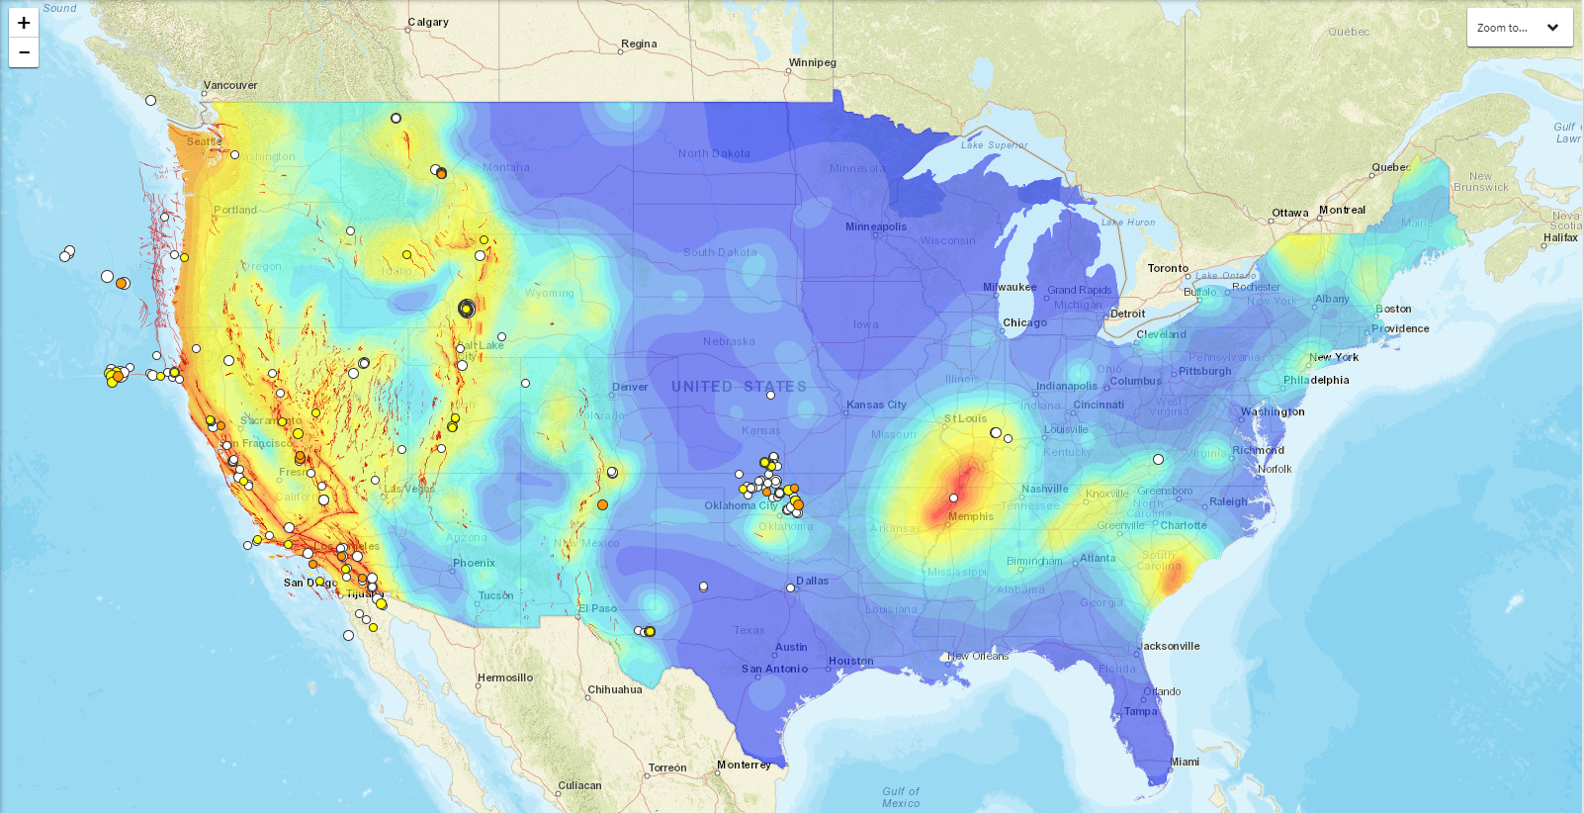


Slide 5





Slide 6
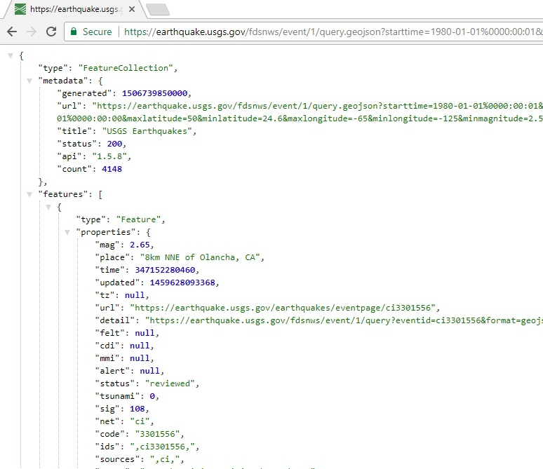
What did we get?
130K Lines of data
36 columns including calculated fields
Data from 1900 to present
How long did it take?
3 minutes!

Slide 7
How did we do it?

Slide 8
How did we do it? Note to self: keep it brief…
Notes:
Transition to GitHub Repository https://github.com/AbrahamEapen/Earthquake-Economics/blob/master/USGS_Final.ipynb

Slide 9
What did the Seismic data tell us?

Slide 10
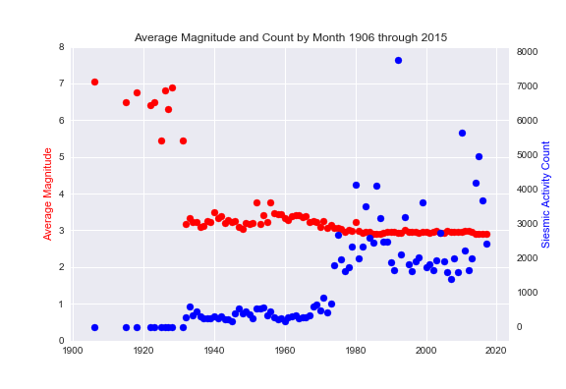

More data = Decreased seismic activity?
The data is Flatlining

Slide 11
Perhaps a different perspective?

Slide 12
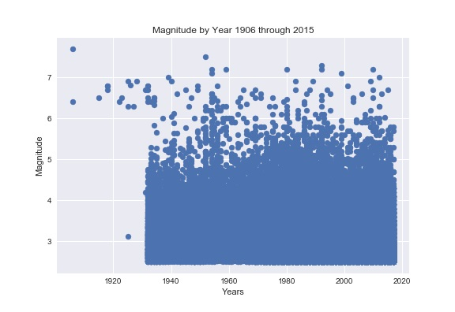
Hummm, something is odd here…

Slide 13
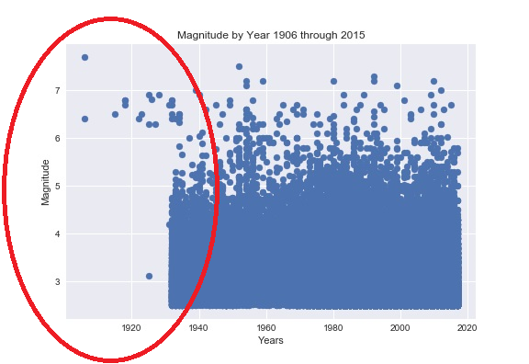
Here’s a hint…

Slide 14
There is an insufficient amount of data prior to the 1930’s.

Slide 15
That’s the big picture….

Slide 16
….let’s dive deeper
Caution: spoilers ahead

Slide 17
First, earthquakes

Slide 18
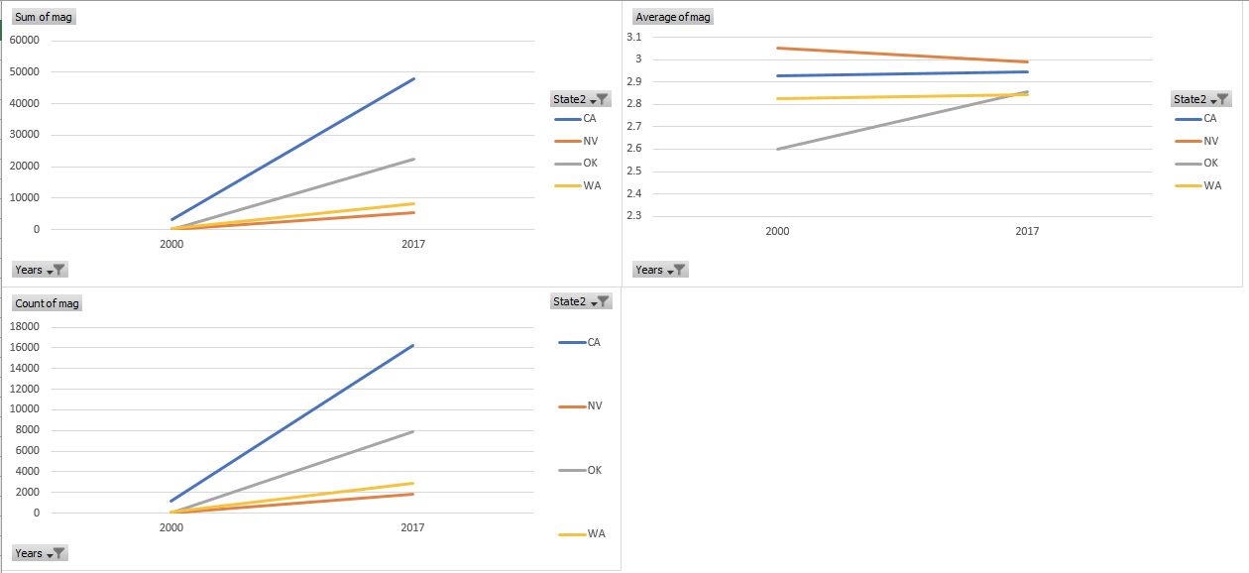
Earthquakes Frequencies and Magnitudes
Earthquake frequency increasing, magnitude in Oklahoma growing significantly stronger
Notes:
Zoom in
Averages
Counts

Slide 19
What’s going on with drilling rigs?

Slide 20
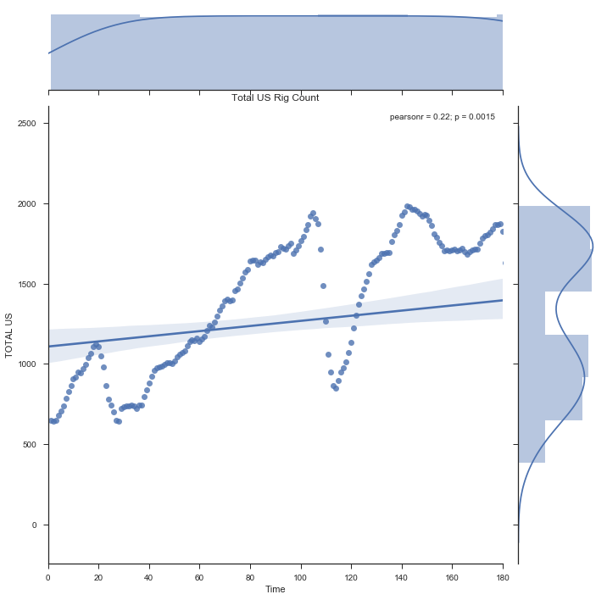
US Rig Count 2000 to December 2013
Rig count data freely available
Data sets go back to 1960 with monthly counts per state
Current chart looking at January 2000 through December 2013
Notes:
-Rig counts increasing
Data freely available

Slide 21
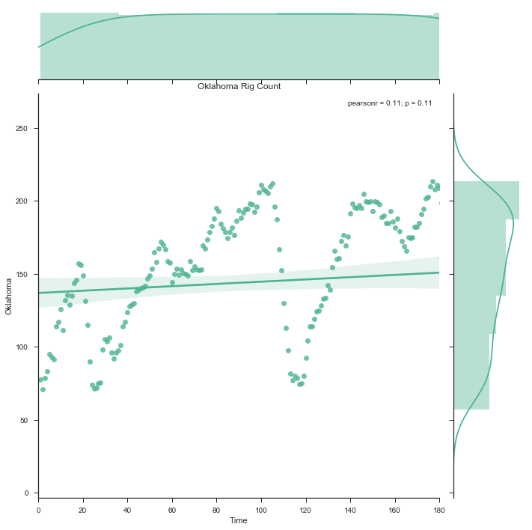
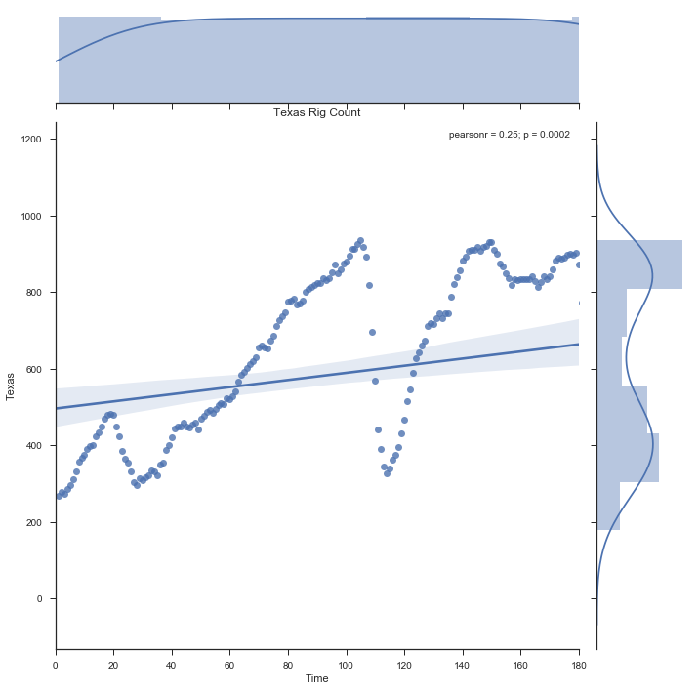
Oklahoma
Texas
Some states have increased rig counts, some have decreased counts
Notes:
States with increasing rig counts also appear to be having more frequent, more intense earthquakes

Slide 22

Q:
What is the impact of 2013 Light to Moderate magnitude earthquakes to the City’s Per Capita Income?

Slide 23
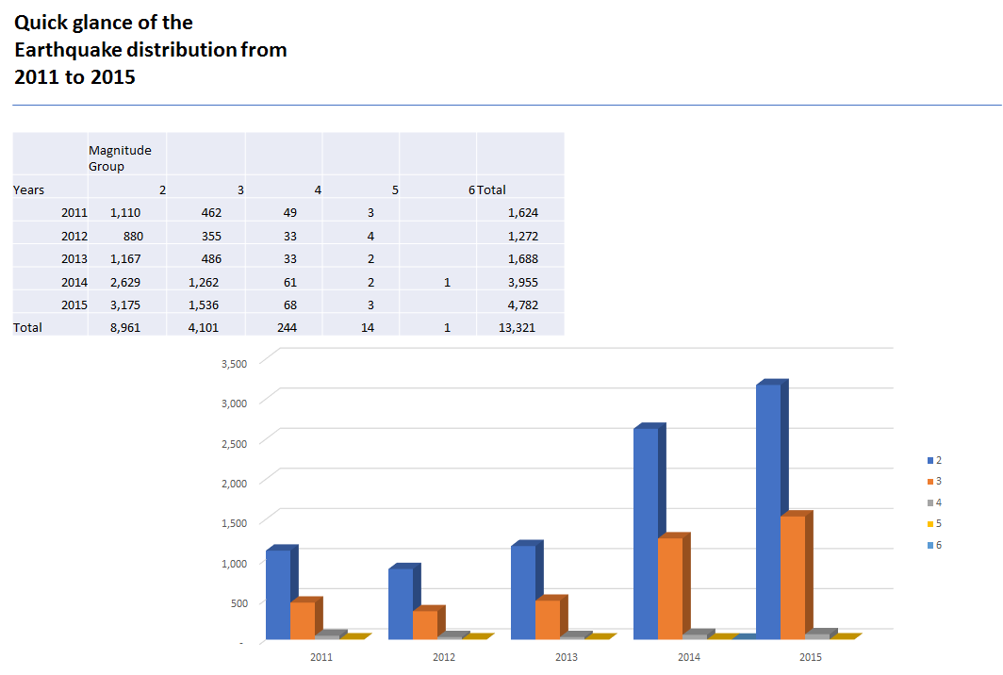

Slide 24
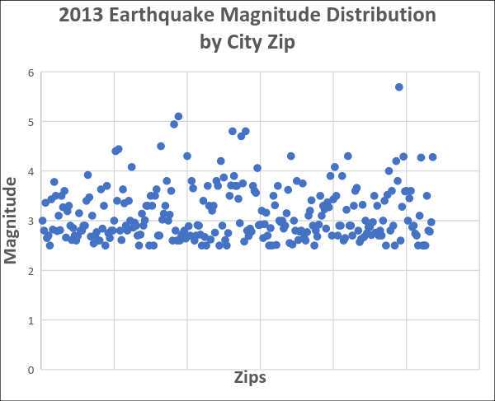
Test Population
Zip Codes that experienced Light to Moderate magnitude earthquake in 2013
Analysis performed at the Zip level of the City nearest to seismic location. Observed population range of 11,000 to 50,000
Earthquake Magnitude Classes
Class | Magnitude
Great | 8 or more
Major | 7 - 7.9
Strong | 6 - 6.9
Moderate | 5 - 5.9
Light | 4 - 4.9
Minor | 3 -3.9

Slide 25
Test Population
19 Zip Codes that experienced Light to Moderate Magnitude of Seismic Activity in 2013
cd_by_year | Nrst City | ZIP | mag | title | Nrst Country | Population_2013 | Per Capita Income_2013 | Per Capita Income_2012 | PCI Change
2013 | susanville | 96130 | 5.69 | M 5.7 - 10km WNW of Greenville, California | us | 21,963 | $ 18,621.00 | $ 19,269.00 | -3%
2013 | fallon | 89406 | 5.1 | M 5.1 - 72km W of Tonopah, Nevada | us | 24,572 | $ 24,716.00 | $ 25,134.00 | -2%
2013 | eureka | 95501 | 4.94 | M 4.9 - 53km WNW of Eureka, California | us | 23,704 | $ 21,122.00 | $ 22,540.00 | -6%
2013 | isla vista | 93117 | 4.8 | M 4.8 - 6km W of Isla Vista, CA | us | 54,251 | $ 22,722.00 | $ 23,379.00 | -3%
2013 | lander | 82520 | 4.8 | M 4.8 - 20km W of Fort Washakie, Wyoming | us | 13,778 | $ 24,971.00 | $ 24,668.00 | 1%
2013 | edmond | 73013 | 4.5 | M 4.5 - 9km ESE of Edmond, Oklahoma | us | 46,457 | $ 38,470.00 | $ 39,266.00 | -2%
2013 | clearlake | 95422 | 4.44 | M 4.4 - 5km WSW of Cobb, California | us | 15,427 | $ 16,552.00 | $ 16,247.00 | 2%
2013 | choctaw | 73020 | 4.4 | M 4.4 - 12km ENE of Luther, Oklahoma | us | 21,499 | $ 29,985.00 | $ 28,890.00 | 4%
2013 | fortuna | 95540 | 4.3 | M 4.3 - 59km W of Ferndale, California | us | 12,877 | $ 21,707.00 | $ 23,116.00 | -6%
2013 | nacogdoches | 75964 | 4.3 | M 4.3 - 3km WNW of Timpson, Texas | us | 19,648 | $ 17,313.00 | $ 17,043.00 | 2%
2013 | ridgecrest | 93555 | 4.3 | M 4.3 - 15km NW of Coso Junction, CA | us | 32,376 | $ 28,697.00 | $ 28,922.00 | -1%
2013 | tehachapi | 93561 | 4.29 | M 4.3 - 22km ESE of Bodfish, CA | us | 34,851 | $ 24,708.00 | $ 24,369.00 | 1%
2013 | yucca valley | 92284 | 4.28 | M 4.3 - 12km W of Ludlow, CA | us | 24,951 | $ 20,534.00 | $ 21,330.00 | -4%
2013 | henderson | 75652 | 4.2 | M 4.2 - 14km WNW of Timpson, Texas | us | 16,185 | $ 19,036.00 | $ 18,815.00 | 1%
2013 | sun valley | 89433 | 4.2 | M 4.2 - 3km NE of Spanish Springs, Nevada | us | 19,630 | $ 17,272.00 | $ 17,241.00 | 0%
2013 | corcoran | 93212 | 4.08 | M 4.1 - 23km NNW of Lost Hills, California | us | 25,618 | $ 8,700.00 | $ 8,998.00 | -3%
2013 | rancho palos verdes | 90275 | 4.08 | M 4.1 - 10km S of Rancho Palos Verdes, CA | us | 42,051 | $ 57,705.00 | $ 58,852.00 | -2%
2013 | lompoc | 93436 | 4.06 | M 4.1 - 45km WSW of Vandenberg Air Force Base, CA | us | 54,433 | $ 22,926.00 | $ 23,177.00 | -1%
2013 | south lake tahoe | 96150 | 4 | M 4.0 - 34km SW of Smith Valley, Nevada | us | 28,686 | $ 25,479.00 | $ 24,996.00 | 2%
% Per Capital Income Change = ((2013 Per Capita Income – 2012 Per Capita Income) / 2012 per Capita income) * 100
Average % Per Capita change: -1.05%

Slide 26
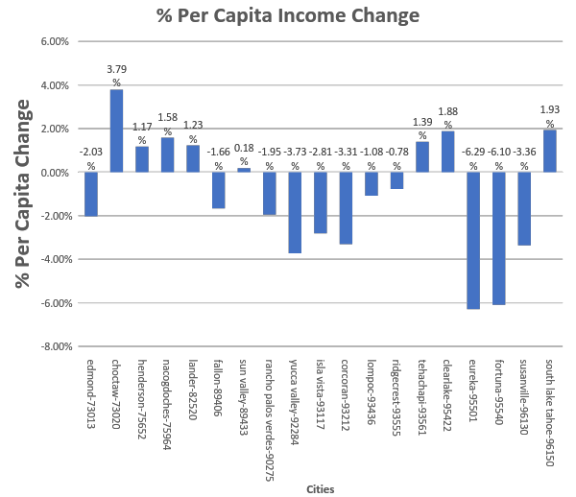
-1.05% Avg Decline in
Per Capita Income
Hypothesis:
Light to Moderate
Earthquake cause a
decline in City’s Per Capita
Income

Slide 27
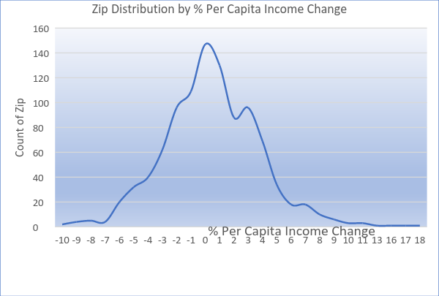
Hypothesis Test
Control Population
Zip Distribution by % Per Capita Income
Change
Using 1,000 random Control population of Zips across the US with population ranging from 11,000 to 50,000
% PCI Change | Count of Zip
-10 | 2
-9 | 4
-8 | 5
-7 | 4
-6 | 20
-5 | 32
-4 | 40
-3 | 62
-2 | 96
-1 | 109
0 | 147
1 | 130
2 | 88
3 | 96
4 | 69
5 | 34
6 | 18
7 | 18
8 | 10
9 | 6
10 | 3
11 | 3
13 | 1
16 | 1
17 | 1
18 | 1
Grand Total | 1000

Slide 28
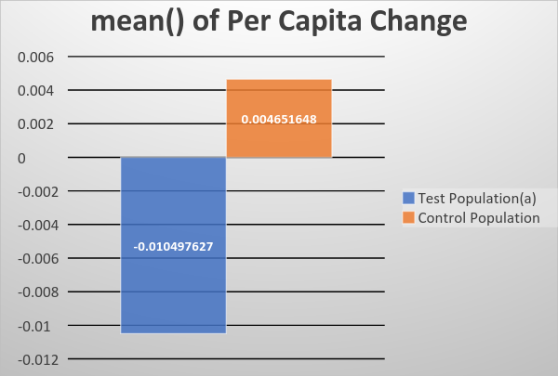
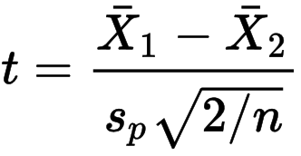
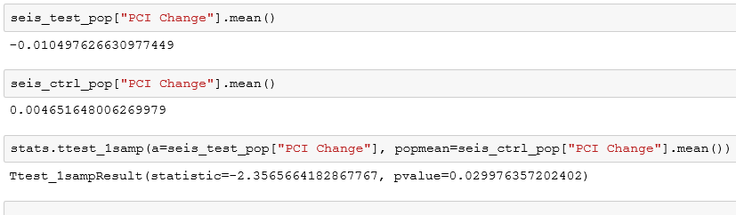
Hypothesis Test
Test performed using t-Test
Test shows a significant level with a
p-value of 0.029976. The analysis concludes that 2013 earthquakes with a magnitude of light to moderate causes a decline in
Per Capita Income by 1.05%
p-value= 0.029976

Slide 29
Q:
Did the 2013 earthquakes caused an increase in Natural Resources and Construction Employment on affected Cities the year after the event?

Slide 30
Test Population
19 Zip Codes that experienced Light to Moderate Magnitude of Seismic Activity in 2013
Year_x | Name_x | Zip | Population_x | Emp Ntrl Rsrces Const_x | Emp Const Extrctn_x | Year_y | Population_y | Emp Ntrl Rsrces Const_y | Emp Const Extrctn_y | Emp Const Extr Change
2013 | ZCTA5 96130 | 96130 | 21963 | 319 | 82 | 2014 | 21920 | 294 | 145 | 0.094763092
2013 | ZCTA5 89406 | 89406 | 24572 | 1261 | 372 | 2014 | 24347 | 1427 | 379 | 0.105939988
2013 | ZCTA5 95501 | 95501 | 23704 | 1136 | 754 | 2014 | 23769 | 943 | 685 | -0.138624339
2013 | ZCTA5 93117 | 93117 | 54251 | 1194 | 574 | 2014 | 55064 | 1443 | 655 | 0.186651584
2013 | ZCTA5 82520 | 82520 | 13778 | 774 | 475 | 2014 | 13840 | 837 | 484 | 0.057646117
2013 | ZCTA5 73013 | 73013 | 46457 | 1353 | 707 | 2014 | 47166 | 1326 | 673 | -0.02961165
2013 | ZCTA5 95422 | 95422 | 15427 | 806 | 395 | 2014 | 15453 | 931 | 317 | 0.039134055
2013 | ZCTA5 73020 | 73020 | 21499 | 1228 | 712 | 2014 | 22063 | 1349 | 743 | 0.078350515
2013 | ZCTA5 95540 | 95540 | 12877 | 618 | 283 | 2014 | 13012 | 604 | 316 | 0.02108768
2013 | ZCTA5 75964 | 75964 | 19648 | 1365 | 903 | 2014 | 19060 | 1114 | 867 | -0.12654321
2013 | ZCTA5 93555 | 93555 | 32376 | 1602 | 685 | 2014 | 32967 | 1558 | 697 | -0.013992129
2013 | ZCTA5 93561 | 93561 | 34851 | 1557 | 752 | 2014 | 34246 | 1500 | 652 | -0.067994803
2013 | ZCTA5 92284 | 92284 | 24951 | 1260 | 727 | 2014 | 25045 | 1110 | 661 | -0.108706593
2013 | ZCTA5 75652 | 75652 | 16185 | 859 | 605 | 2014 | 16438 | 816 | 539 | -0.074453552
2013 | ZCTA5 89433 | 89433 | 19630 | 950 | 632 | 2014 | 19544 | 974 | 743 | 0.085335019
2013 | ZCTA5 93212 | 93212 | 25618 | 1528 | 310 | 2014 | 25204 | 1643 | 318 | 0.066920566
2013 | ZCTA5 90275 | 90275 | 42051 | 435 | 304 | 2014 | 42420 | 495 | 346 | 0.138024357
2013 | ZCTA5 93436 | 93436 | 54433 | 3084 | 1039 | 2014 | 55176 | 3190 | 1120 | 0.045355324
2013 | ZCTA5 96150 | 96150 | 28686 | 1377 | 822 | 2014 | 28618 | 1324 | 890 | 0.006821282
% NR&C Employment Change = ((2014 Natrl Res-Construc Emp – 2013 Natrl Res-Construc Emp) / 2013 Natrl Res-Construc Emp) * 100
Average % NR&C Empl Change : 1.93%

Slide 31
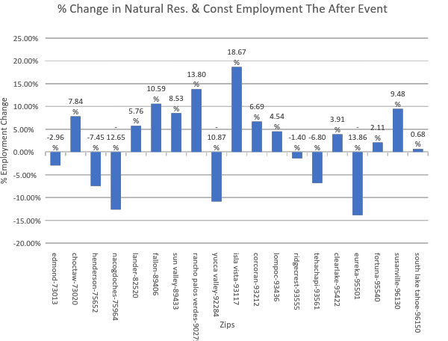
1.93% Avg Increase in
Employment
Hypothesis:
Light to Moderate
Earthquake caused an increase
In Natural Resources &
Construction employment
the year after the event

Slide 32
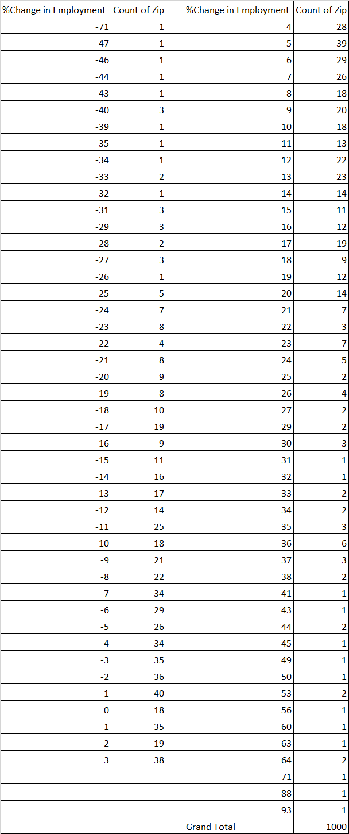
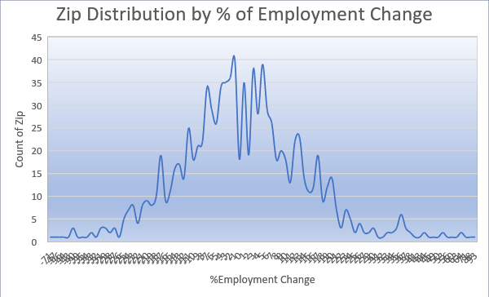
Hypothesis Test
Control Population
Using 1,000 random Control population of Zips across the US.

Slide 33
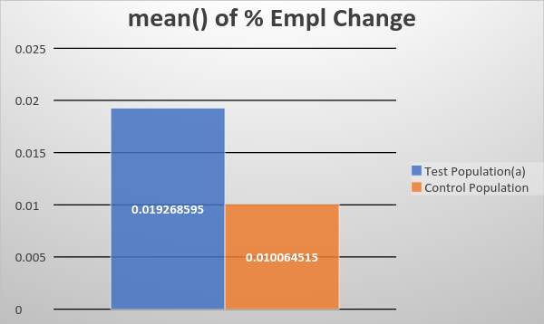
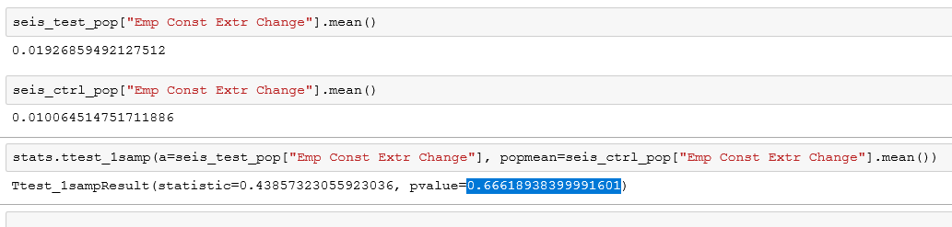
Hypothesis Test
Test performed using t-Test
The test is not significant enough to reject the null hypothesis, with a
p-value of 0.6661.
Hence, the increase of employment in Natural Resources and Construction the year following the 2013 earthquakes is driven by other factors and not by the year’s seismic events.
p-value= 0.666189

Slide 34
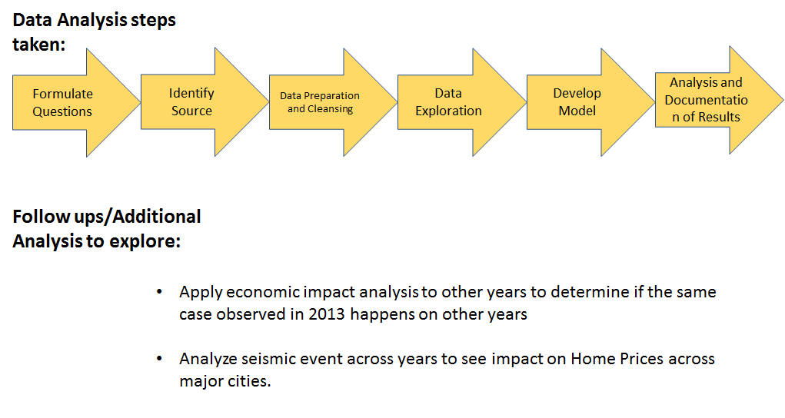

Slide 35
Challenges
Data Formatting
Data Visualizations
Are Earthquake Seasonally?
Epoch Time

Slide 36
Takeaways
Chicken or Egg:
Are earthquake being due to Oil Rig Industry or are Seismic areas prime targets of the Petroleum Industry.
Data is better everyday:
Although data is flattening over time across the United States, certain states are seeing peaks whereas other are seeing valleys
Economic Impact:
Based on the 2013 subject using multiple samples and iterations, analysis shows that Light to Moderate seismic events caused a decline in Per Capita Income. The analysis also shows that these events didn’t have significant impact on Employment particularly in Natural Resources & Construction industry.

